Slide 1
Advanced Web programming
Lec-2
C# Language
(Ref- Beginning of Asp.net 4.5 in C #- Pg no:13……)

Slide 2
The .NET Class Library
The .NET class library is a giant repository of classes similar to Java, that provide prefabricated functionality for everything from reading an XML file to sending an e-mail message.
Any .NET language can use the .NET class library’s features by interacting with the right objects. This helps encourage consistency among different .NET languages and removes the need to install numerous components on your computer or web server.
Some parts of the class library include features you’ll never need to use in web applications (such as the classes used to create desktop applications with Windows interfaces).
Other parts of the class library are targeted directly at web development, that include the base set of classes that define common variable types and the classes for data access.
The class library is similar to as a well-stocked programmer’s toolkit.
Microsoft’s philosophy is that it will provide the tedious infrastructure so that application developers need only to write business-specific code.

Slide 3
Visual Studio
The part of .NET is the Visual Studio development tool, which provides a rich environment where you can rapidly create advanced applications. So all professional ASP.NET developers use a design tool such as Visual Studio.
Some of the features of Visual Studio include the following:
Page design: You can create an attractive page with drag-and-drop ease by using Visual Studio’s integrated web form designer. Without understanding of HTML.
Automatic error detection: You could save hours of work when Visual Studio detects and reports an error before you run your application. Potential problems are underlined, just like the “spell-as-you-go” feature found in many word processors.
Debugging tools: Visual Studio retains its legendary debugging tools, which allow you to watch your code in action and track the contents of variables. And you can test web applications just as easily as any other application type, because Visual Studio has a built-in web server that works just for debugging.
IntelliSense: Visual Studio provides statement completion for recognized objects and automatically lists information such as function parameters in helpful tooltips.
The .NET Framework ships with two core languages that are commonly used for building ASP.NET applications: C# and VB.

Slide 4
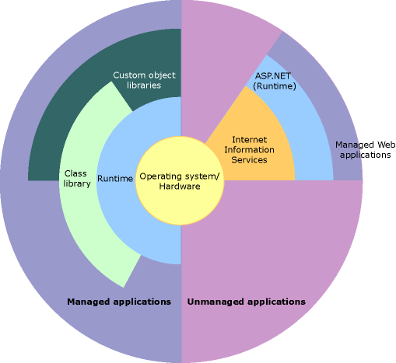

Slide 5
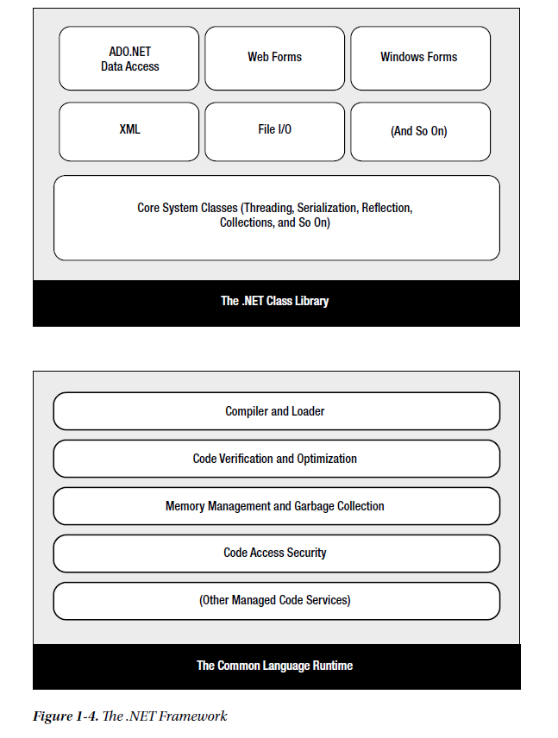

Slide 6
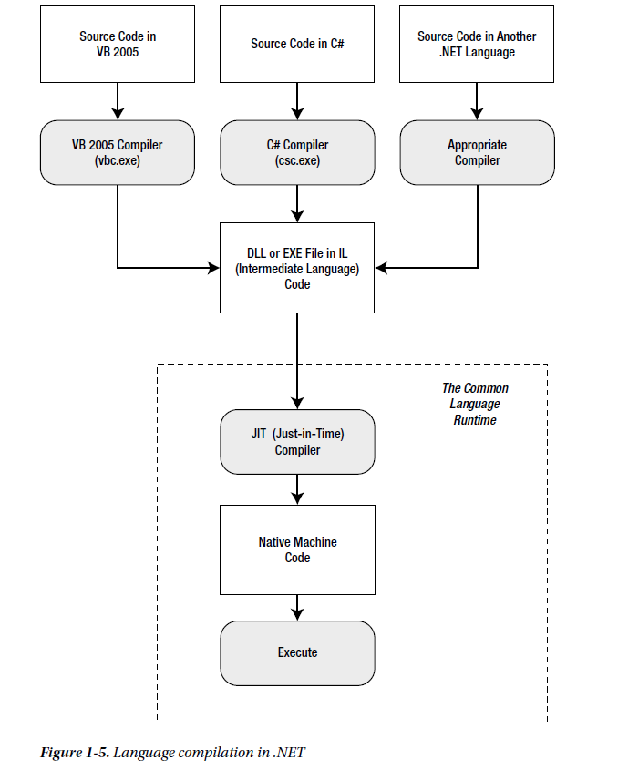

Slide 7
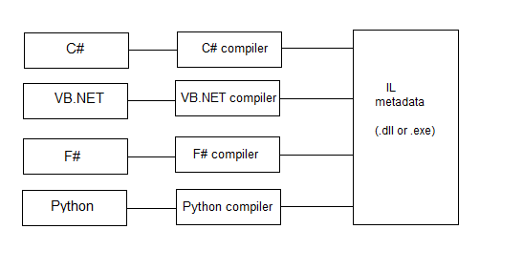
Fig: Basic Language Compilation

Slide 8
.NET also allows other third-party developers to release languages that are just has feature-rich as C# or VB.
Their new compiler can transform their code creations into a sequence of Intermediate Language (IL) instructions, just as the VB and C# compilers do with VB and C# code.
IL is the only language that the Common Language Runtime (CLR) recognizes. When you create the code for an ASP.NET web form, it’s changed into IL using the C# compiler (csc.exe) or the VB compiler ().

Slide 9
C# Languages
Four general principles you need to know about C#
1. Case Sensitivity
Some languages are case-sensitive, while others are not. Java, C, C++, and C# are all examples of case-sensitive languages. VB is not.
For example, if you try to create a conditional statement in C# by entering If instead of if, your code will not be recognized, and the compiler will flag it with an error when you try to build your application.
C# also has a definite preference for lowercase words.
Keywords—such as if, for, foreach, while, typeof, and so on—are always written in lowercase letters.
It means, private variables names that start with a lowercase letter and public variables names that start with an initial capital letter.

Slide 10
2. Commenting
Comments are lines of descriptive text that are ignored by the compiler.
C# provides two basic types of comments.
The first type is the single-line comment & second is multiple-line comments.
In single-line comment case, the comment starts with two forward slashes and
continues for the entire current line:
// A single-line C# comment.
C# programmers can use /* and */ comment brackets to indicate multiple-line comments:
/* A multiple-line
C# comment. */
Multiple-line comments are often used to quickly disable an entire block of code. This trick is called
“commenting out your code”
/*
... Any code here is ignored ...
*/
This way, the code won’t be executed, but it will still remain in your source code file if you need to refer to it or use it later.

Slide 11
3. Statement Termination
C# uses a semicolon (;) as a statement-termination character.
Every statement in C# code must end with this semicolon, except when you’re defining a block structure.
By omitting the semicolon, you can easily split a statement of code over multiple physical lines. The semicolon at the end of the last line to end the statement is necessary.
The following code snippet demonstrates four equivalent ways to perform the same operation (adding three numbers together):
// A code statement on a single line.
myValue = myValue1 + myValue2 + myValue3;
// A code statement split over two lines.
myValue = myValue1 + myValue2 +
myValue3;

Slide 12
// A code statement split over three line.
myValue = myValue1 +
myValue2 +
myValue3;
// Two code statements in a row.
myValue = myValue1 + myValue2;
myValue = myValue + myValue3;

Slide 13
4. Blocks
Curly braces group multiple code statements together.
Typically, code statements are grouped since they are repeated in a loop, executed conditionally, or grouped into a function. These are all block structures.
But in each case, the curly braces play the same role, which makes C# simpler and more concise than other languages that need a different syntax for each type of block structure.
{
// Code statements go here.
}

Slide 14
Variables and Data Types
With all programming languages, you keep track of data in C# by using Variables.
Variables can store numbers, text, dates, and times, and they can even point to full-fledged objects.
When you declare a variable, you give it a name and specify the type of data it will store.
To declare a local variable, you start the line with the data type, followed by the name you want to use. A final semicolon ends the statement.
// Declare an integer variable named errorCode.
int errorCode;
// Declare a string variable named myName.
string myName;
In C# the variables name and Name aren’t equivalent! To confuse matters even more, C programmers sometimes use this fact to their advantage—by using multiple variables that have the same name but with different capitalization. This technique is sometimes useful when distinguishing between private and public variables in a class, but you should avoid it if there’s any possibility for confusion.

Slide 15
Every .NET language uses the same variable data types.
Since languages share the same core data types, you can easily use objects written in one .NET language in an application written in another .NET language. No data type conversions are required.
All .NET languages have the same data types because they all adhere to the common type system (CTS).
To create this common data type system, Microsoft cooked up a set of basic data types, which are provided in the .NET class library.

Slide 16
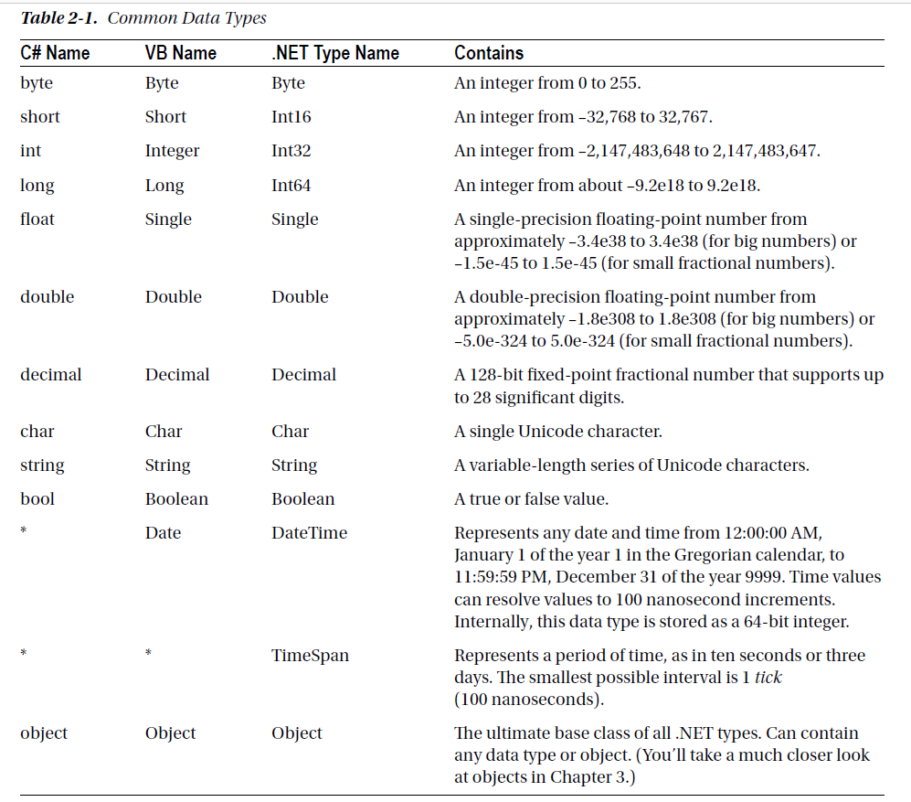

Slide 17
You can also declare a variable by using the type name from the .NET class library.
This approach produces identical variables. It’s also a requirement when the data type doesn’t have an alternate name built into the language.
For example, you can rewrite the earlier example that used C# data type names with this code that uses the class library names:
System.Int32 errorCode; 🡨 (int errorCode;)
System.String myName; 🡨 (string myName;)
This code uses fully qualified type names that indicate that the Int32 data type and the String data type are found in the System namespace (along with all the most fundamental types).

Slide 18
Assignment and Initializers
After declaring the variables, you can freely assign values to them, as long as these values have the correct data type.
Here’s the code that shows this two-step process:
// Declare variables.
int errorCode;
string myName;
// Assign values.
errorCode = 10;
myName = "Matthew";

Slide 19
You can also assign a value to a variable in the same line that you declare it.
int errorCode = 10;
string myName = "Matthew";
C# safeguards you from errors by restricting you from using uninitialized variables.
For example, the following code causes an error when you attempt to compile it:
int number; // Number is uninitialized.
number = number + 1; // This causes a compile error.
The proper way to write this code is to explicitly initialize the number variable to an appropriate value, such as 0, before using it:
int number = 0; // Number now contains 0.
number = number + 1; // Number now contains 1.

Slide 20
C# also deals strictly with data types.
For example, the following code statement won’t work as written:
decimal myDecimal = 14.5;
The problem is that the literal 14.5 is automatically interpreted as a double, and you can’t convert a double to a decimal without using casting syntax.
For this problem, C# defines a few special characters that you can append to literal values to indicate their data type so that no conversion will be required. These characters are as follows:
• M (decimal)
• D (double)
• F (float)
• L (long)
For example, you can rewrite the earlier example by using the decimal indicator as follows:
decimal myDecimal = 14.5M;

Slide 21
If you’re using code like this to declare and initialize your variable in one step, and if the C# compiler can determine the right data type based on the value you’re using, you don’t need to specify the data type.
Instead, you can use the all-purpose var keyword in place of the data type. That means the previous line of code is equivalent to this:
var myDecimal = 14.5M; (decimal myDecimal = 14.5M;)
Here, the compiler realizes that a decimal data type is the most appropriate choice for the myDecimal variable and uses that data type automatically. There is no performance difference.

Slide 22
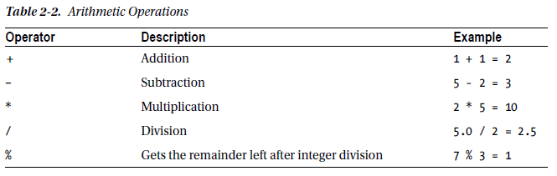
Variable Operations
All the standard types of variable operations in C# can be used.
When working with numbers, various math symbols, as listed in Table 2-2.
C# follows the conventional order of operations, performing exponentiation first, followed by multiplication and division and then addition and subtraction. You can also control order by grouping subexpressions with parentheses:
int number;
number = 4 + 2 * 3;
// number will be 10.
number = (4 + 2) * 3;
// number will be 18.

Slide 23
If you divide one integer by another integer, C# performs integer division. That means it automatically discards the fractional part of the answer and returns the whole part as an integer.
Eg: If you divide 5 by 2, you’ll end up with 2 instead of 2.5. The solution is to explicitly indicate that one of your numbers is a fractional value.
Eg: If you replace 5 with 5 M, C# will treat the 5 as a decimal. If you replace 5 with 5.0, C# will treat it as a double. Either way, the division will return the expected value of 2.5.

Slide 24
C# also allows you to use the addition operator ( + ) to join two strings:
// Join three strings together.
myName = firstName + " " + lastName;
In addition, C# provides special shorthand assignment operators.
// Add 10 to myValue.
This is the same as myValue = myValue + 10;
myValue += 10;
// Multiple myValue by 3.
This is the same as myValue = myValue * 3;
myValue *= 3;
// Divide myValue by 12.
This is the same as myValue = myValue / 12;
myValue /= 12;

Slide 25
Advanced Math
A centralized Math class is the part of the .NET Framework.
To use the math operations, the methods of the System.Math class can be invoked, which is static so available & ready to use.
The following code shows some sample calculations that you can perform with the Math class:
double myValue;
myValue = Math.Sqrt(81); // myValue = 9.0
myValue = Math.Round(42.889, 2); // myValue = 42.89
myValue = Math.Abs(-10); // myValue = 10.0
myValue = Math.Log(24.212); // myValue = 3.18.. (and so on)
myValue = Math.PI; // myValue = 3.14.. (and so on)

Slide 26
Type Conversions
Converting information from one data type to another is a common programming task.
Conversions are of two types:
1. Widening
2. narrowing
1. Widening conversions always succeed.
Eg: you can always convert a 32-bit integer into a 64-bit integer without any special code.
int mySmallValue;
long myLargeValue;
// Get the largest possible value that can be stored as a 32-bit integer.
// .NET provides a constant named Int32.MaxValue that provides this number.
mySmallValue = Int32.MaxValue;
// This always succeeds. No matter how large mySmallValue is,
// it can be contained in myLargeValue.
myLargeValue = mySmallValue;

Slide 27
2. Narrowing conversions
It may or may not succeed, depending on the data. If you’re converting a 32-bit integer to a
16-bit integer, you could encounter an error.
C# uses an elegant method for explicit type conversion.
To convert a variable, you simply need to specify the type in parentheses before the expression
you’re converting.
The following code shows how to change a 32-bit integer to a 16-bit integer:
int count32 = 1000;
short count16;
// Convert the 32-bit integer to a 16-bit integer.
// If count32 is too large to fit, .NET will discard some of the information you need, the
resulting number will be incorrect.
count16 = (short)count32;
This process is called Casting.

Slide 28
To avoid these type of problem, you should either check that your data is not too large before you attempt a narrowing conversion (which is always a good idea) or use a checked block.
The checked block enables overflow checking for a portion of code. If an overflow occurs, you’ll automatically receive an error, just as you would in VB:
checked
{
// This will cause an exception to be thrown.
mySmallValue = (int)myLargeValue;
}

Slide 29
In C#, you can’t use casting to convert numbers to strings, or vice versa. The data isn’t just being moved from one variable to another—it needs to be translated to a completely different format.
.NET has a number of solutions for performing advanced conversions. One option is to use the static methods of the Convert class, which support many common data types such as strings, dates, and numbers.
string countString = "10";
// Convert the string "10" to the numeric value 10 (won’t work if the string contains letters or other non-numeric characters).
int count = Convert.ToInt32(countString);
// Convert the numeric value 10 into the string "10".
countString = Convert.ToString(count);

Slide 30
The “Convert” class is a good all-purpose solution, but other static methods are also available in .NET class library.
static Int32.Parse() method to perform the same task:
int count;
string countString = "10";
// Convert the string "10" to the numeric value 10.
count = Int32.Parse(countString);

Slide 31
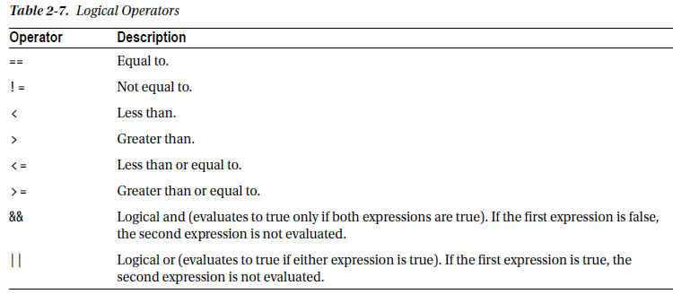
Conditional Logic
Conditional logic is deciding which action to take based on user input, external conditions, or other information is the heart of programming.
All conditional logic starts with a condition: a simple expression that can be evaluated to true or false.
To build a condition, you can use any combination of literal values or variables along with logical operators.

Slide 32
With string data types, only the equality operators (== and ! = ) are used.
C# doesn’t support other types of string comparison operators—instead, the String.Compare() method is used.
The String.Compare() method deems that a string is “less than” another string.
The return value from String.Compare is 0 if the strings match, 1 if the first supplied string is greater than the second, and –1 if the first string is less than the second.
Eg: int result;
result = String.Compare("apple", "attach"); // result = -1(if the first string is less than the second)
result = String.Compare("apple", "all"); // result = 1(if the first string is greater)
result = String.Compare("apple", "apple"); // result = 0 (if the strings match)
// Another way to perform string comparisons.
string word = "apple";
result = word.CompareTo("attach"); // result = -1

Slide 33
The if Statement
The if statement is the powerhouse of conditional logic, able to evaluate any combination of conditions and deal
with multiple and different pieces of data. Here’s an example with an if statement that features two else conditions:
if (myNumber > 10)
{
// Do something.
}
else if (myString == "hello")
{
// Do something.
}
else
{
// Do something.
}

Slide 34
The switch Statement
C# also provides a switch statement that you can use to evaluate a single variable or expression for multiple possible values.
The only limitation is that the variable you’re evaluating must be an integer-based data type, a bool, a char, a string, or a value from an enumeration. Other data types aren’t supported.
The C# syntax inherits the convention of C/C++ programming, which requires that every branch in a switch statement be ended by a special break keyword in the program.

Slide 35
In the following code, each case examines the myNumber variable and tests whether it’s equal to a specific integer:
switch (myNumber)
{
case 1:
// Do something.
break;
case 2:
// Do something.
break;
default:
// Do something.
break;
}

Slide 36
Loops
Loops allow to repeat a segment of code multiple times.
C# has three basic types of loops.
1. You can loop a set number of times, with a for loop.
2. You can loop through all the items in a collection of data, by using a foreach loop.
3. You can loop while a certain condition holds true, with a while or do...while loop.
The for and foreach loops are ideal for sets of data that have known, fixed sizes.
The while loop is a more flexible construct that allows you to continue processing until a complex condition is met.
The while loop is often used with repetitive tasks or calculations that don’t have a set number of iterations.

Slide 37
Topics
1. Methods
2. parameters
3. Method overloading
4. Optional & Named parameters
5. Delegates
6. Object-Based Manipulation (Pg 28-34)

Slide 38
Methods
Methods are the most basic building block you can use to organize your code.
A method is a named grouping of one or more lines of code. Ideally, each method will perform a distinct, logical task.
By breaking down your code into methods, it is easier to organize your code into classes.
When declaring a method decide whether you want to return any information or not.
For example, a method named GetStartTime() might return a DateTime object that represents the time an application was first started i.e one piece of data.
When you declare a method in C#, the first part of the declaration specifies the data type of the return value, and the second part indicates the method name.
If your method doesn’t return any information, you should use the void keyword instead of a data type at the beginning of the declaration.

Slide 39
Examples- one method that doesn’t return anything and one that does:
Eg 1: // This method doesn’t return any information.
void MyMethodNoReturnedData()
{
// Code goes here.
}
Eg 2: // This method returns an integer.
int MyMethodReturnsData()
{
// As an example, return the number 10.
return 10;
}

Slide 40
The method name is always followed by parentheses ‘()’, which allows the compiler to recognize that it’s a method.
An accessibility keyword (such as public or private) can also be added,
private void MyMethodNoReturnedData()
{
// Code goes here.
}
The accessibility determines how different classes in your code can interact. Private methods are hidden from view and are available only locally, whereas public methods can be called by all the other classes in your application. If you don’t specify accessibility, the method is always private.

Slide 41
Invoking the methods is straightforward—you simply type the name of the method, followed by parentheses. If your method returns data, you have the option of using the data it returns or just ignoring it:
// This call is allowed.
MyMethodNoReturnedData();
// This call is allowed.
MyMethodReturnsData();
// This call is allowed.
int myNumber;
myNumber = MyMethodReturnsData();
// This call isn’t allowed.
// MyMethodNoReturnedData() does not return any information.
myNumber = MyMethodNoReturnedData();

Slide 42
Parameters
Methods can also accept information through parameters.
Parameters are declared in a similar way to variables.
By convention, parameter names always begin with a lowercase letter in any language.
Eg: Create a function that accepts two parameters and returns their sum:
private int AddNumbers(int number1, int number2)
{
return number1 + number2;
}

Slide 43
When calling a method, you specify any required parameters in parentheses or use an empty set of parentheses if no parameters are required:
// Call a method with no parameters.
MyMethodNoReturnedData();
// Call a method that requires two integer parameters.
MyMethodNoReturnedData2(10, 20);
// Call a method with two integer parameters and an integer return value.
int returnValue = AddNumbers(10, 10);

Slide 44
Method Overloading
C# supports method overloading, which allows you to create more than one method with the same name but with a different set of parameters.
When you call the method, the CLR automatically chooses the correct version by examining the parameters you supply.
This technique allows you to collect different versions of several methods together.
Eg: You might allow a database search that returns an array of Product objects representing records in the database.
Rather than create three methods with different names depending on the criteria, such as GetAllProducts(), GetProductsInCategory(), and GetActiveProducts(), you could create three versions of the GetProducts() method.
Each method would have the same name but a different signature, meaning it would require different parameters.

Slide 45
This example provides two overloaded versions for the GetProductPrice() method:
private decimal GetProductPrice(int ID)
{
// Code here.
}
private decimal GetProductPrice(string name)
{
// Code here.
}

Slide 46
decimal price;
// Get price by product ID (the first version).
price = GetProductPrice(1001);
// Get price by product name (the second version).
price = GetProductPrice("DVD Player");
You cannot overload a method with versions that have the same signature—that is, the same number of parameters and parameter data types—because the CLR will not be able to distinguish them from each other.
When you call an overloaded method, the version that matches the parameter list you supply is used. If no version matches, an error occurs.

Slide 47
Optional and Named Parameters
Method overloading is a time-honored technique for making methods more flexible, so you can call them in a variety of ways.
C# also has another feature that supports the same goal: optional parameters.
An optional parameter is any parameter that has a default value.
If your method has normal parameters and optional parameters, the optional parameters must be placed at the end of the parameter list.
Eg: This method has a single optional parameter:
private string GetUserName(int ID, bool useShortForm = false)
{
// Code here
}

Slide 48
Here, the useShortForm parameter is optional, which gives you two ways to call the GetUserName() method:
// Explicitly set the useShortForm parameter.
name = GetUserName(401, true);
// Don't set the useShortForm parameter, and use the default value (false).
name = GetUserName(401);
Sometimes you’ll have a method with multiple optional parameters,
private decimal GetSalesTotalForRegion(int regionID, decimal minSale = 0,
decimal maxSale = Decimal.MaxValue, bool includeTax = false)
{
// Code here
}

Slide 49
Also you can pick out the parameters you want to set by name. This feature is called named parameters, and to use it you simply add the parameter name followed by a colon (:), followed by the value, as shown:
total = GetSalesTotalForRegion(523, maxSale: 5000);
Method overloading allows you to deal with either/or situations, while optional parameters do not.
Eg: GetProductPrice() method shown in the previous section required a string or an integer.
It’s not acceptable to make both of these into optional parameters, because at least one is required, and supplying the two of them at once makes no sense. Thus, this is a situation where method overloading fits more naturally.

Slide 50
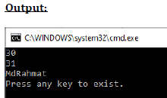
Method Overloading Program
using System;
class Program
{
public void add(int a, int b)
{
Console.WriteLine(a + b);
}
public void add(float x, float y)
{
Console.WriteLine(x + y);
}
public void add(string s1, string s2)
{
Console.WriteLine(s1 + s2);
}
static void Main(string[] args)
{
Program obj = new Program();
obj.add(10, 20);
obj.add(10.5f, 20.5f);
obj.add("Md", "Rahmat");
Console.WriteLine("Press any key to exist.");
Console.ReadKey();
}
}

Slide 51
Delegates
Delegates allow you to create a variable that “points” to a method. You can use this variable at any time to invoke the method. Delegates help you write flexible code that can be reused in many situations. They’re also the basis for events.
A delegate is a reference type variable that holds the reference to a method.
The first step when using a delegate is to define its signature.
The signature is a combination of several pieces of information about a method: its return type, the number of parameters it has, and the data type of each parameter.
A delegate variable can point only to a method that matches its specific signature.
Eg: If you have a method that accepts a single string parameter and another method that accepts multiple string parameters, you’ll need to use a separate delegate type for each method since one method has single string & other has multiple.

Slide 52
Homework: 20/06/2022
Given string is Advanced Web Programming
Convert the given string into Upper case, Lower case, replace q with x, add AWP at the end of the string.

Slide 53
private string TranslateEnglishToFrench(string english)
{
// Code goes here.
}
This method accepts a single string argument and returns a string. With those two details in mind, you can define a delegate that matches this signature
private delegate string StringFunction(string inputString);
Once you’ve defined a type of delegate, you can create and assign a delegate variable at any time. Using the StringFunction delegate type, you could create a delegate variable like this ‘functionReference’:
StringFunction functionReference;
Using your delegate variable, you can point to any method that has the matching signature. In this example, the StringFunction delegate type requires one string parameter and returns a string.

Slide 54
Thus, you can use the functionReference variable to store a reference to the TranslateEnglishToFrench() method;
functionReference = TranslateEnglishToFrench;
[When you assign a method to a delegate variable in C#, you don’t use brackets after the method name. This indicates that you are referring to the method, not attempting to execute it. If you added the parentheses, the CLR would attempt to run your method and convert the return value to the delegate type, which wouldn’t work and give compile error]
Now that you have a delegate variable that references a method, you can invoke the method through the delegate.
string frenchString;
frenchString = functionReference("Hello");

Slide 55
The method that the functionReference delegate points to will be invoked with the parameter value "Hello", and the return value will be stored in the frenchString variable.
// Create a delegate variable.
StringFunction functionReference;
// Store a reference to a matching method in the delegate.
functionReference = TranslateEnglishToFrench;
// Run the method that functionReference points to.
// In this case, it will be TranslateEnglishToFrench().
string frenchString = functionReference("Hello");

Slide 56
In a more complex application, one method would create the delegate variable, and another method would use it. The benefit in this scenario is that the second method doesn’t need to know where the delegate points. Instead, it’s flexible enough to use any method that has the right signature.

Slide 57
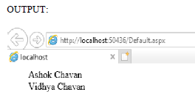
Delegate Problem
public partial class _Default : System.Web.UI.Page
{
public delegate string dele();
public static string display1()
{
string s1="Ashok Chavan";
return s1;
}
public static string display2()
{
string s2="Vidhya Chavan";
return s2;
}
protected void Page_Load(object sender, EventArgs e)
{
dele d1 = new dele(display1);
d1();
dele d2 = new dele(display2);
d2();
Label1.Text = d1();
Label2.Text = d2();
}
}

Slide 58
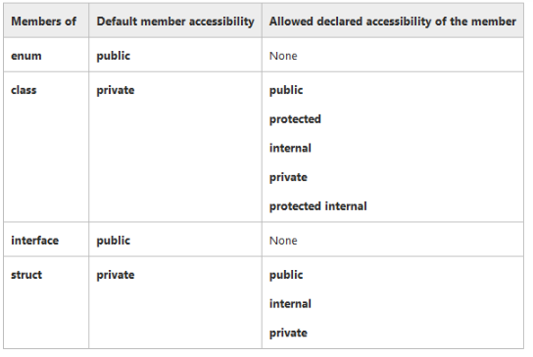

Slide 59
Assignment
1. Explain for, foreach & While loops in C# with example.
(ref pg no.37-39)

